Slide 1
A Model of Two Tales: Dual Transfer Learning Framework for Improved Long-tail Item Recommendation
Year : 2021
Conference : WWW
Author : Zhang Yin

Slide 2
Innovation
This paper proposes a novel dual transfer learning framework that jointly learns the knowledge transfer from both model-level and item-level : model-level and item-level.

Slide 3
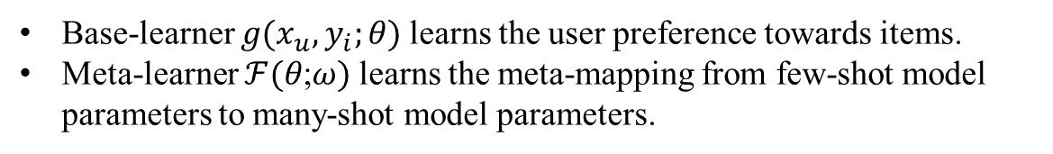
Part one : Transfer learning across models : Meta-level Knowledge Transfer
There are two key learners in the meta-level knowledge transfer
Base-learner $g(x_{u},y_{i};\text{θ})$learns the user preference towards items.
Meta-learner $ℱ(\text{θ}\text{;}ω)$learns the meta-mapping from few-shot model parameters to many-shot model parameters.

Slide 4
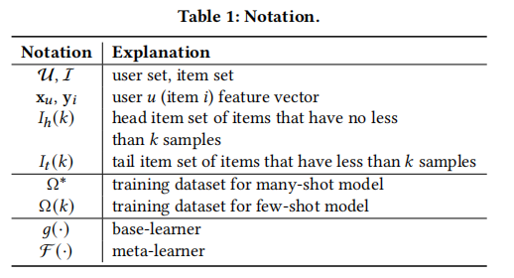






1 . Base-learner
Two-tower MLP neural network learns latent representations
User tower $g_{u}(x_{u};\text{θ})$
Item tower $g_{i}(y_{i};\text{θ})$
Output ${s\left(x_{u},y_{i};\text{θ}\right)=<g}_{u}\left(x_{u};\text{θ}\right),g_{i}\left(y_{i};\text{θ}\right)>$
Softmax
Loss

Slide 5


2 . Meta-learner
Learn the many-shot model parameters $θ^{∗}$
Final objective function
Focus on the model parameters in the last layer of user and item towers
A fully connected layer as the mapping network for $ℱ$(·)
The loss function that simultaneously trains the few-shot model and meta-mapping offers both the high-quality of base-learner recommendation and high accuracy of meta-learner model mapping.

Slide 6
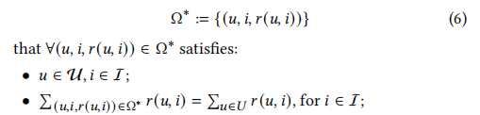
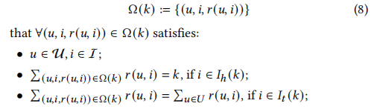
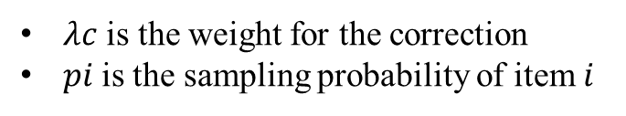
Part two : Transfer Learning Across Items : Curriculum Transfer
There are two key learners in the meta-level knowledge transfer
Long-Tail distribution-aware Curriculum strategy ( LTCur )
logQ correction:
$λc$ is the weight for the correction
$pi$is the sampling probability of item 𝑖

Slide 7
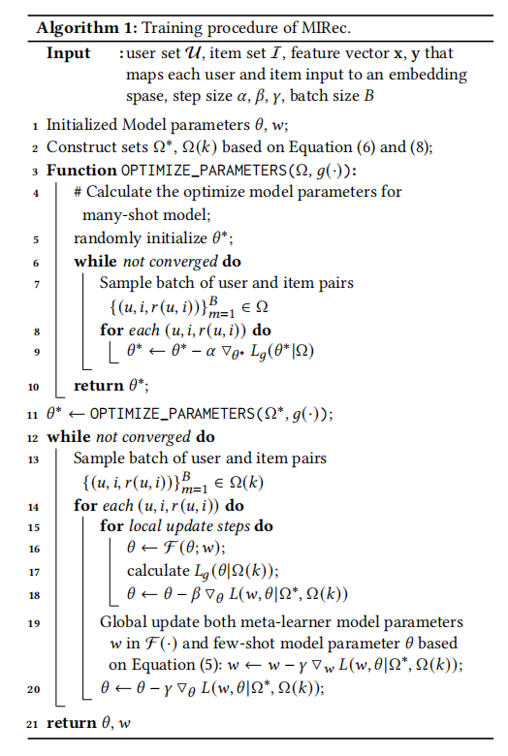

Slide 8

Part three : Prediction by MIRec
The base-learner could offer a better representations for head items rather than ones by meta-mapping.
Therefore, to predict the user preference towards both head and tail items, we combine the representation learned from both the base-learner and meta-mapped base-learner.

